Slide 1

Road Accident Analysis (2023 & 2024)

Slide 2

Problem Statement
India faces one of the highest road accident fatality rates globally.
Large datasets remain underutilized for safety interventions.
Need for actionable insights to guide policy makers and stakeholders.

Slide 3
Dataset Overview
Dataset: Road accident records (2023 & 2024).
Total Records: ~417,882 casualties.
Fields: Accident type, casualties, location, time, road type.
Sources: Government accident statistics & road safety data

Slide 4
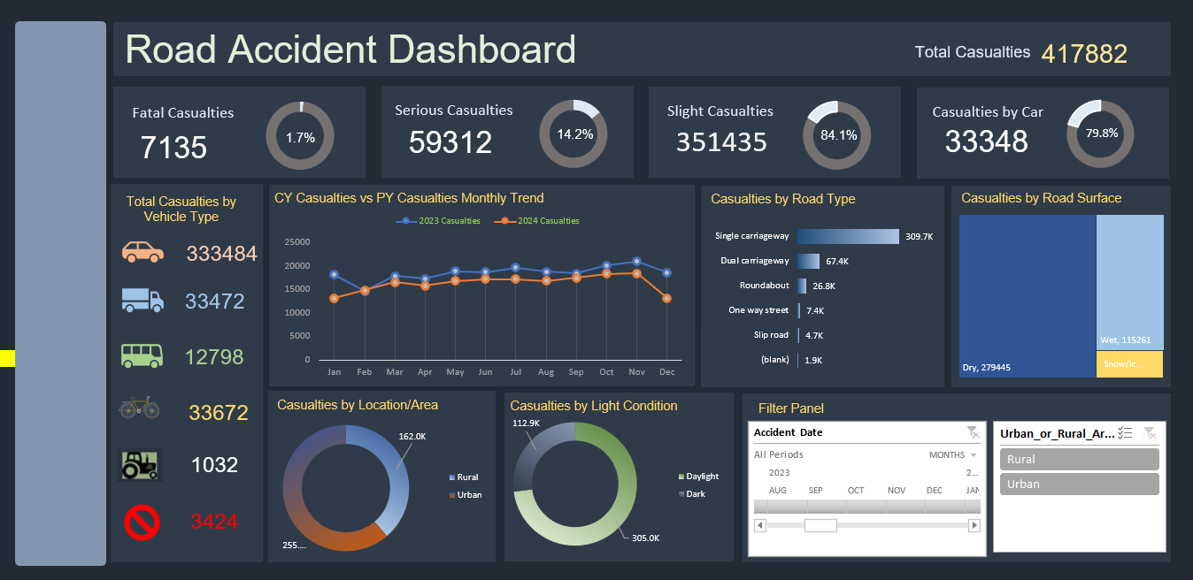
Dashboard

Slide 5

Key Insights
Rural accidents: 162,018 casualties vs Urban: 255,864
Day vs Night: 113k casualties at night → higher fatality risk
Slip roads & one-way streets show disproportionately high accidents
Seasonal trends: Jan & Mar spikes, indicating risky periods

Slide 6

Strategic Recommendations
Targeted rural safety programs (awareness + infrastructure).
Night-time accident prevention: Better lighting, reflective signage.
Policy intervention for high-risk roads (slip roads, one-way streets).
Seasonal campaigns in peak months (Jan, Mar).
Data-driven coordination between 6+ agencies for road safety.

Slide 7
Conclusion
The analysis highlights critical accident hotspots and risk factors.
By adopting data-backed interventions, stakeholders can:
- Reduce fatalities significantly
- Improve road safety infrastructure
- Align national and state-level agencies for impact

